Slide 1


BVRIT HYDERABAD College of Engineering for Women Department of Information Technology
Automated Question Generator using NLP
Under the Guidance of Team – 10
Guide Name :Ms. K.S Niraja 19WH1A1205 - G. Harshitha
Designation : Assistant Professor 19WH1A1208 - B. Keerthi
19WH1A1222 - Ch. Mithiksha
19WH1A1247 – T. Ramya Sri

Slide 2
Contents
Abstract
Introduction
Problem Definition
Literature Survey
Proposed System
Project Modules
Implementation and Results
Performance Measures
Conclusion
References

Slide 3
Abstract
The purpose of this system is to generate questions and evaluating their answers automatically.
It takes text as input then it summarizes and generates questions using T5 Model.
KeyBERT library used for keyword extraction.
Distractors are generated using the Wordnet and Sense2Vec approach.

Slide 4
Introduction
Most of the organizations will assign a members to go through the material and manually create MCQ based questions.
As we can see it is a lot of time consuming.
So there is a growing need for a system that can create questions with ease and less amount of time and requires less human effort.
This system solves the problem of manual creation of questions and reduces time consumption and cost.

Slide 5
Problem Statement
To build a system that generates questions automatically.
This system requires the input of a target topic and will generate questions whose answers will be found on the paragraph itself.

Slide 6
Literature Survey
Author | Year | Title | Description | Techniques
[3] D. R. CH and S. K. Saha | 2021 | Automatic Multiple Choice Question Generation From Text: A Survey | In this system, articles from the database are used to generate questions. | NLP-Based summarizer, pattern matching techniques, Wordnet
[4] Deepshree S. Vibhandik Rucha C. Samant | 2020 | Automatic / Smart Question Generation System for Academic Purpose | This system generates specific trigger questions and multiple-choice questions from student's literature review papers and also pulling out abbreviations. | Lingo Algorithm
[1]Santhanavijayan,A.,Balasundaram,S.R.,HariNarayanan, S., Vinod Kumar, | 2019 | Automatic generation of multiple-choice questions for e-assessment | The method analyses the questions by summarising the text contents. The system also creates analogy questions to test the verbal ability of the students. | Fireflies-based preference learning, Ontology-based approach

Slide 7
Proposed System
The proposed system creates automated questions with the help of NLP that
reduces human intervention and it is a cost and time effective system.
It solves the problem of creating questions manually.
Using Key BERT for keyword extraction.
WordNet, Sense2Vec used for generating distractors.

Slide 8
Project Modules
Abstractive / Extractive Summarization
Extracting Keywords
Question Generation
Generating Distractors
Gradio UI Visualization.

Slide 9
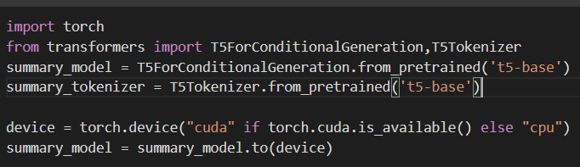
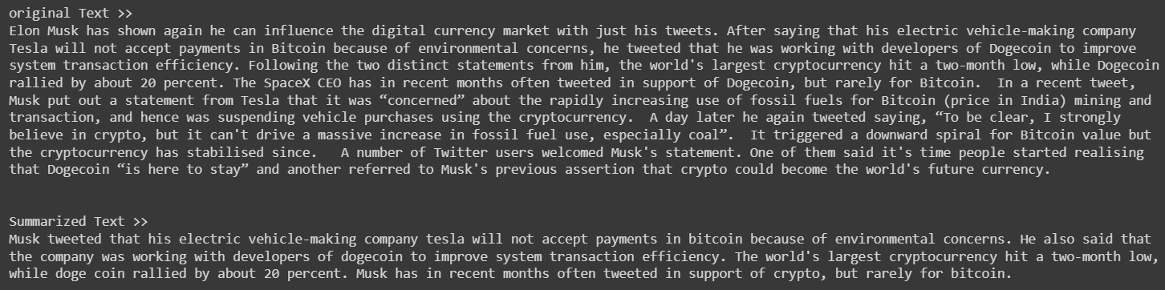
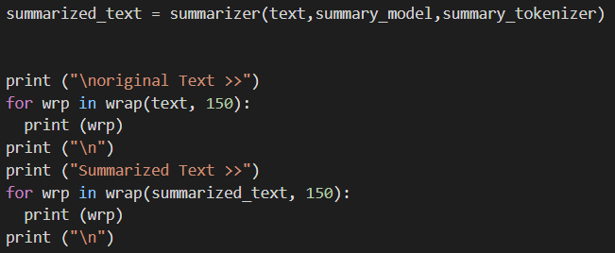
Implementation and Results
Summarization

Slide 10
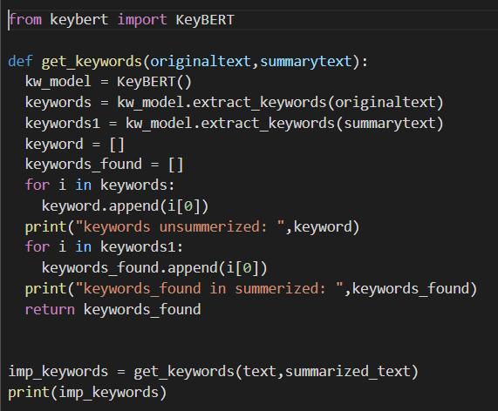
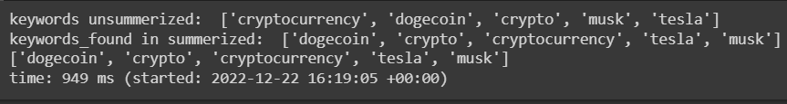
Implementation and Results
Keyword Extraction

Slide 11

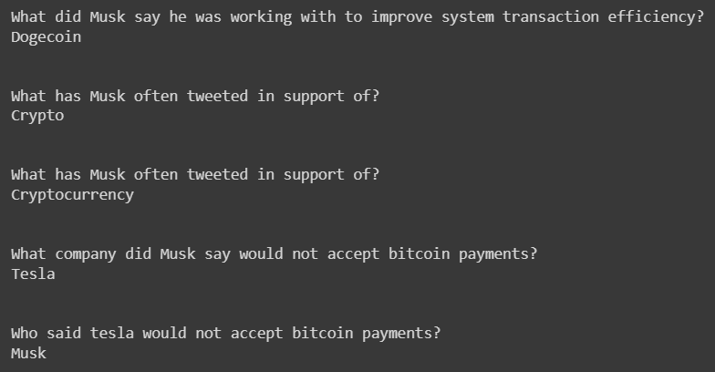
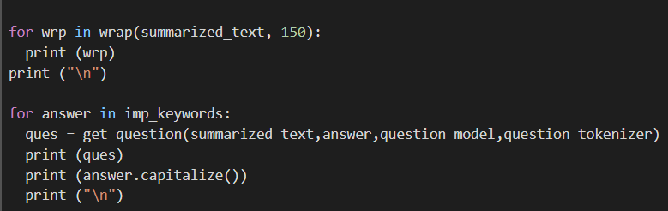
Implementation and Results
Question Generation

Slide 12
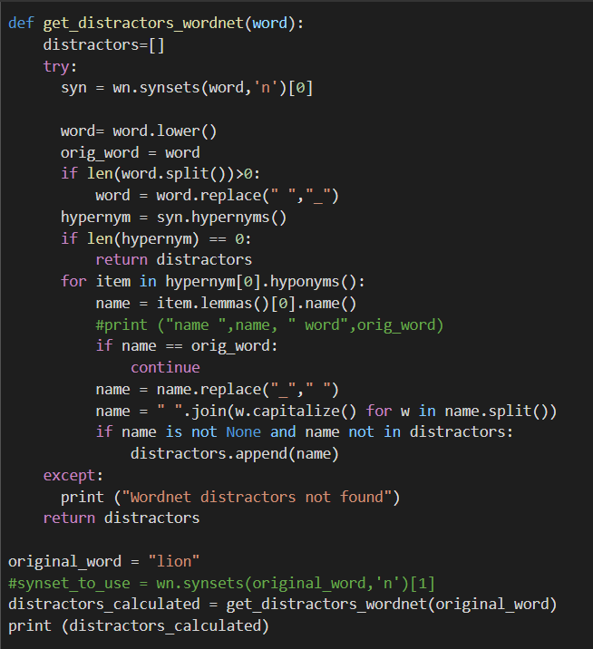
Implementation and Results
Generating distractors using wordnet

Slide 13
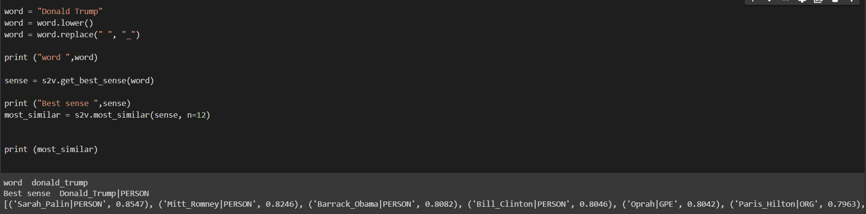
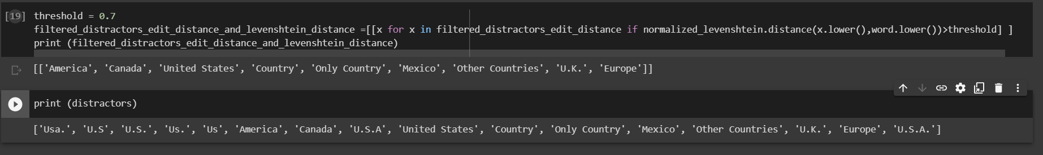
Implementation and Results
Generating distractors using sense2vec

Slide 14
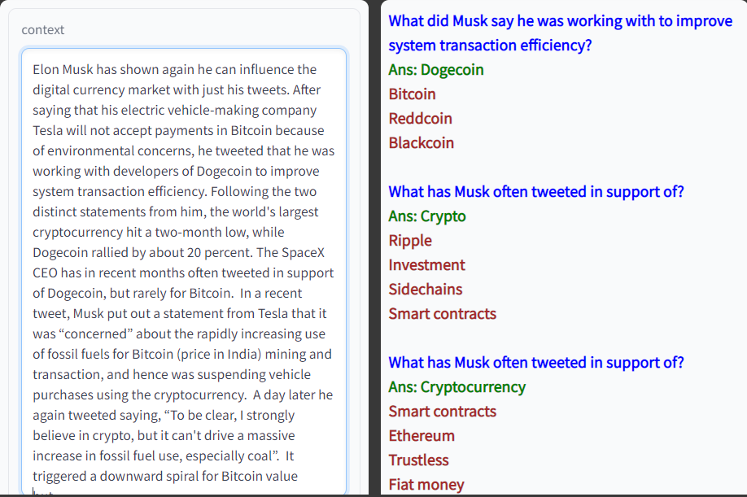
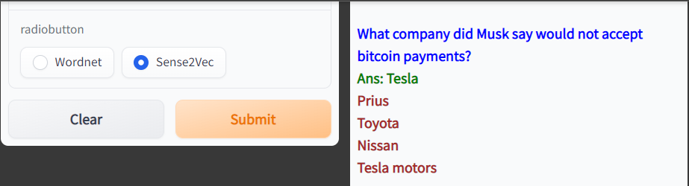
Implementation and Results
Output

Slide 15
Performance Measures
Used T5 Model for summarization as it gives better performance compared to BERT Algorithm.
Used Key BERT algorithm for keyword extraction which gives efficient results than PKE(Python Keyword Extraction).
Wordnet, Sense2vec is used for generating distractors.

Slide 16
Conclusion
The problem of manually creating questions is solved with the proposed system. The proposed system creates automated questions with the help of NLP that reduces human intervention and it is a cost and time effective system. And the accuracy of the distractor generated is reasonably high. This system not only helps teachers with E-assessments but also helps students who are preparing for competitive exams. Students can test their ability to solve the questions and can also check their understanding of the concepts.

Slide 17
References
D. R. CH and S. K. Saha, “Automatic Multiple Choice Question Generation From Text: A Survey,” in IEEE Transactions on Learning Technologies, vol. 13, no. 1, pp. 14-25, 1 Jan.-March 2021, doi: 10.1109/TLT.2018.2889100.
Deepshree S. Vibhandik, Rucha C. Samant “Automatic / Smart Question Generation System for Academic Purpose”, International Journal of Emerging Trends & Technology in Computer Science (IJETTCS), Volume 4, Issue 4, July - August 2020.
Santhanavijayan, A., Balasundaram, S.R., Hari Narayanan, S., Vinod Kumar, S., and Vignesh Prasad, V. (2019) ‘Automatic generation of multiple-choice questions for e-assessment’, Int. J. Signal and Imaging Systems Engineering, Vol. 10, Nos. 1/2, pp.54–62

Slide 18
THANK YOU

